Slide 1



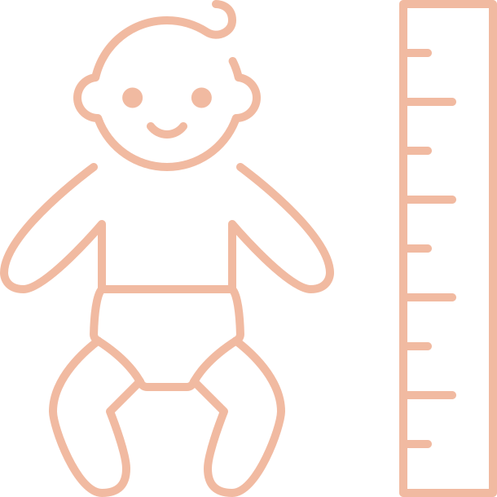
OLIVIA
19 JUNE 2026
6:30am | 3200g | 51cm

